Slide 1
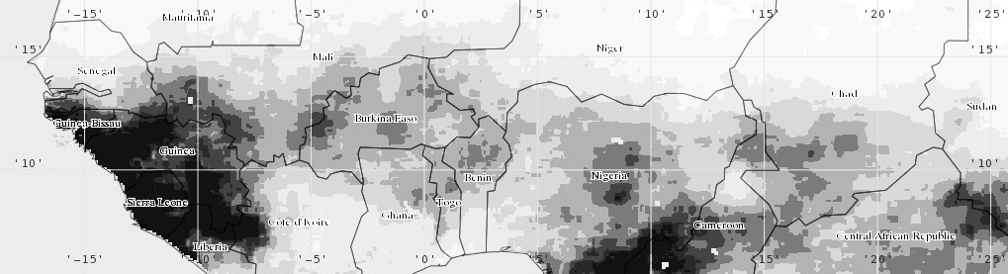
APPLICATIONS OF VIC FOR CLIMATE/ LAND COVER CHANGE IMPACTS
Kel Markert
NASA-SERVIR Mekong Regional Associate
University of Alabama in Huntsville | Earth System Science Center
8 March 2017

Slide 2
OUTLINE
Introduction
Research Question
Data and Methods
Land Cover Change Model
Hydrologic Model
Analysis
Results
Conclusions

Slide 3
INTRODUCTION
Study focuses on the Lower Mekong Basin (LMB)
The LMB is an economically and
ecologically important region
One of the largest exporters
of rice and fish products
[Sakamoto et al., 2006;
Poulsen et al., 2002)
Within top three most
biodiverse river basins in
the world [Dudgeon, 2000]
Natural climate variability plays an important role in water supply within the region
Short-term climate variability (ENSO, MJO)
Long-term climate variability (climate change)

Slide 4
INTRODUCTION
Projections of climate change show there will be a decrease in water availability world wide which has implications for food security and ecology [Mancosu, et al., 2015]
Additional studies show there may be socioeconomic turmoil due to water wars and food security in developing regions such as the Mekong Basin [Mainuddin et al, 2011; Peasrse-Smith, 2012]

Slide 5
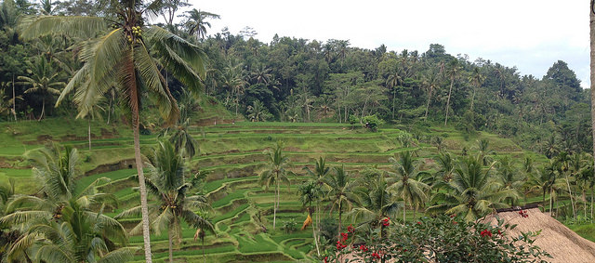
INTRODUCTION
Southeast Asia has experienced major changes in land use and land cover from 1980 – 2000 [Fox & Vogler, 2005]
Major economic reforms resulting in shift from subsistence farming to market-based agricultural production [Rigg, 2006]
Changes in land cover continue to occur which have an important role within the land surface aspect of hydrology
Source: WWF
Public domain photo

Slide 6
RESEARCH QUESTION
How will climate variability and land cover change affect the spatial and temporal characteristics of the hydrological system within the LMB?
Hypothesis:
Climate scenarios will result in decrease of water/streamflow with increased temperatures and changes in precipitation intensity and patterns
Increases in simulated agricultural land will yield increases in runoff (increases in forest land will yield decreases in runoff)
The system is more sensitive to climate variability than land cover change, as precipitation is a major driving force for hydrology

Slide 7
RESEARCH OUTLINE
Develop Land Cover Change Model
Run Land Cover Scenarios
Land Cover Data
Calibration and Validation
Setup VIC Hydrologic Model
Run Hydrologic Simulations
NEX Climate Data
Calibration and Validation
Precip. Bias Correction
Gridded Hydrologic Forcing
Climate Variability Effects
Analysis
Land Cover Change Effects

Slide 8
LAND COVER CHANGE MODEL
Develop Land Cover Change Model
Run Land Cover Scenarios
Land Cover Data
Calibration and Validation
Setup VIC Hydrologic Model
Run Hydrologic Simulations
NEX Climate Data
Calibration and Validation
Precip. Bias Correction
Gridded Hydrologic Forcing
Climate Variability Effects
Analysis
Land Cover Change Effects

Slide 9
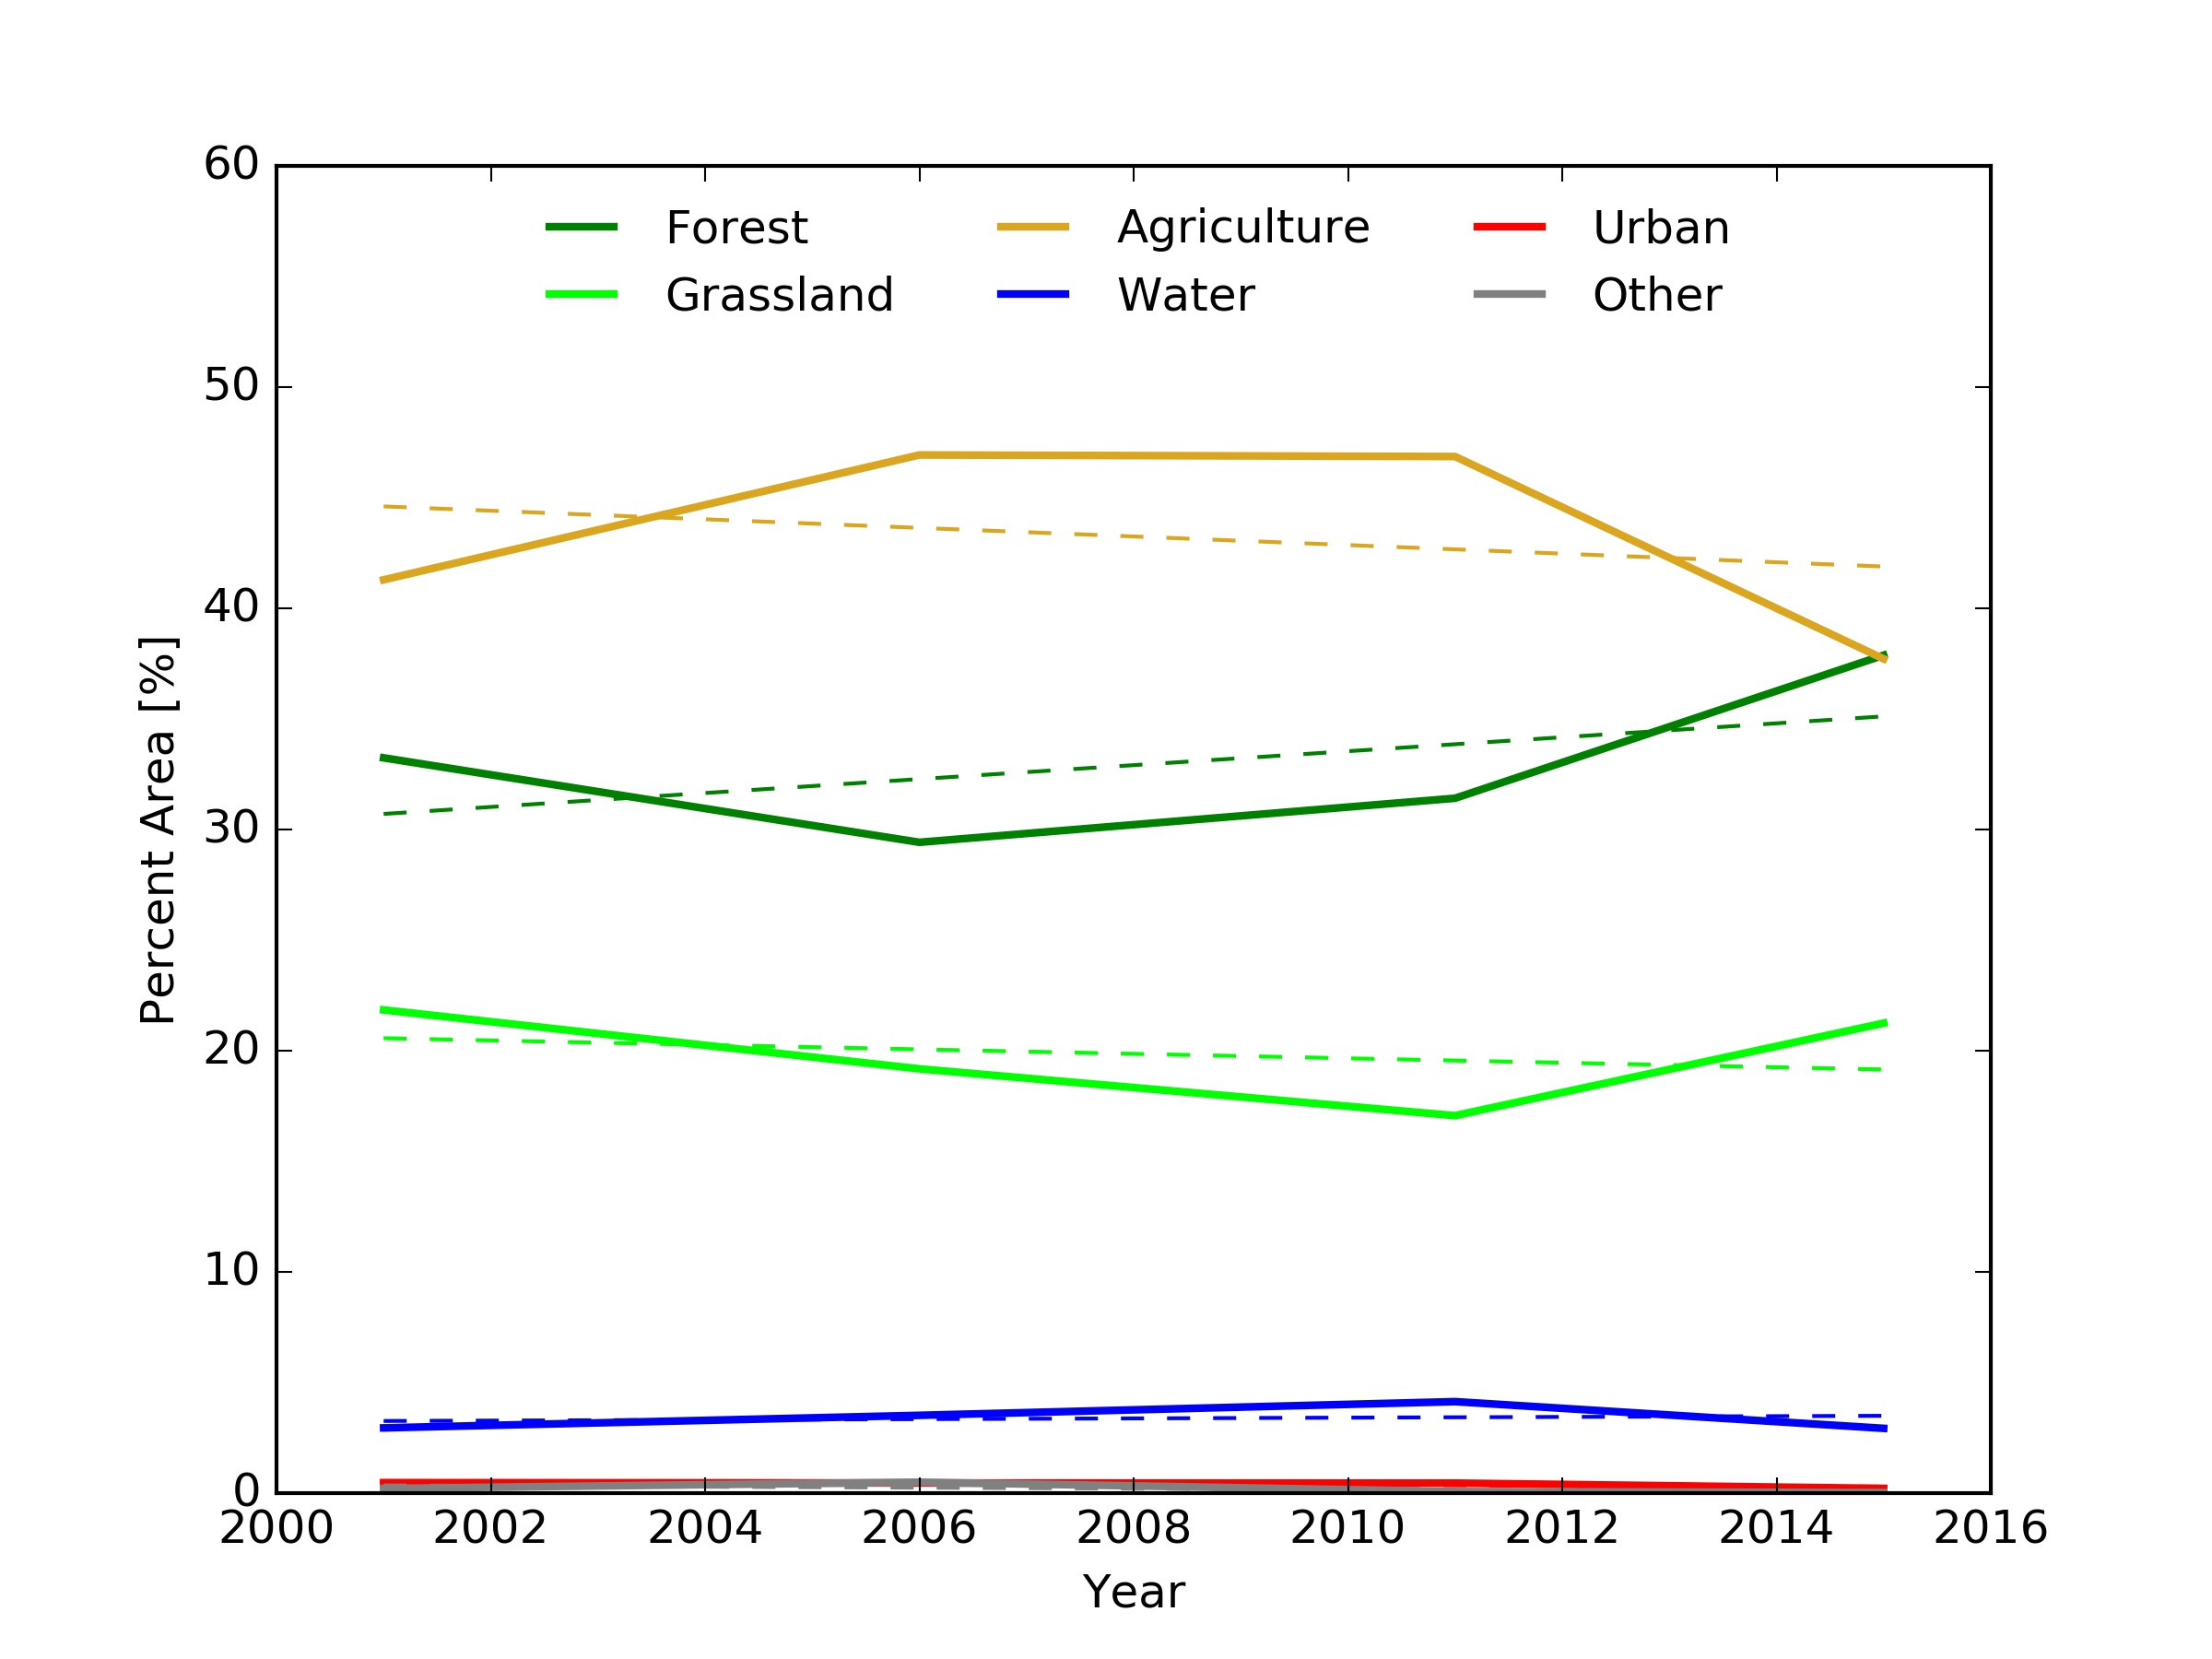
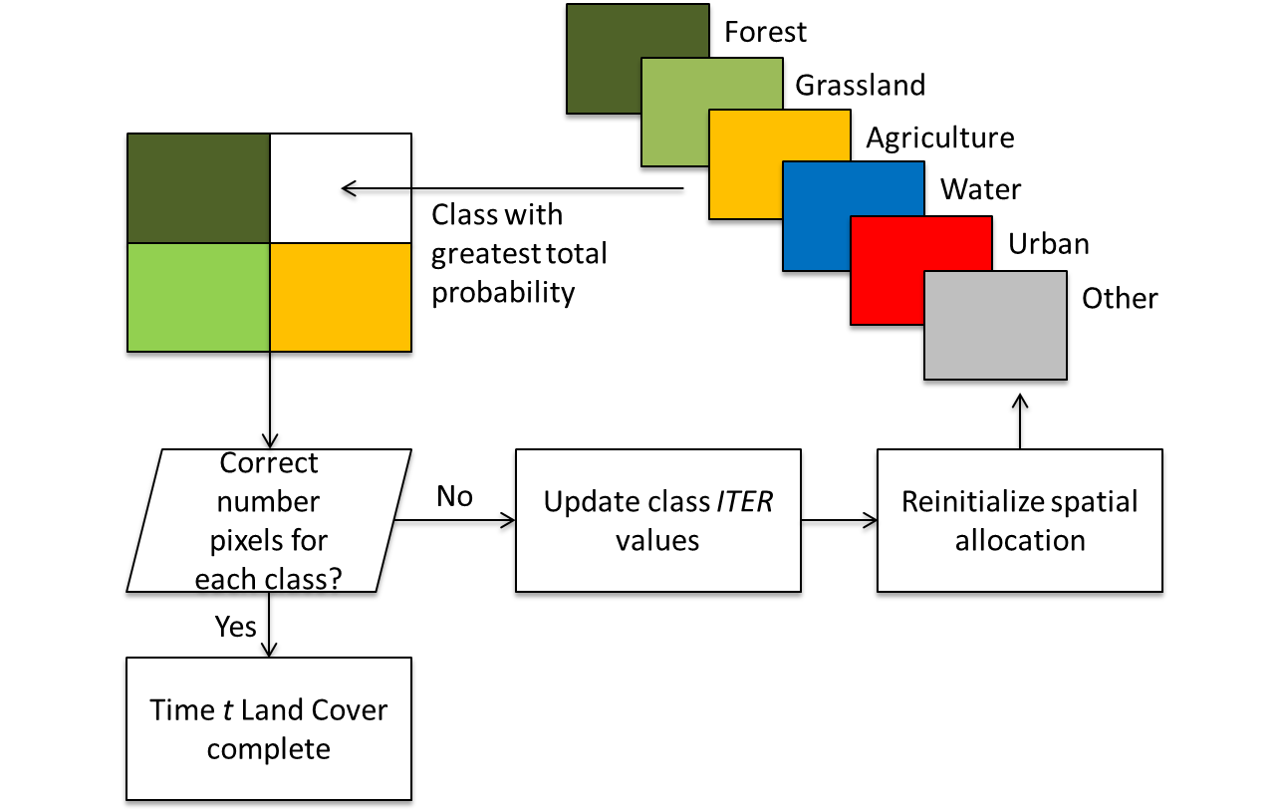
LAND COER CHANGE MODEL
Land cover change model is based on the CLUE-S model framework [Verburg et al., 2002]
The model contains two components to estimate land cover at a given place at a given time
Non-spatial component (demand for land cover type)
Spatial component (probability of land cover type and spatial allocation of land cover type)
NON-SPATIAL
SPATIAL

Slide 10
LAND COVER CHANGE MODEL
Current model is based on six land cover classes from Intergovermental Panel on Climate Change (IPCC) land cover classification
Consistent with other
climate modeling efforts
Limits the complexity of
the modeling
approach leading to
fewer misclassifications

Slide 11
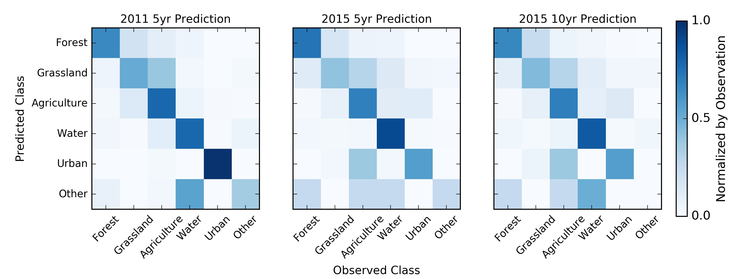
LAND COVER MODEL PERFORMANCE
Stratified random sample to compare predicted vs observed land cover for 2011 and 2015 (n = 740)
Simulation Year | Overall Accuracy | Producer’s Accuracy | User’s Accuracy | Kappa Statistic
2011 | 71.95 % | 68.00 % | 70.61 % | 0.64
2015 (5 yr.) | 67.97 % | 59.10 % | 55.30 % | 0.57
2015 (10 yr.) | 66.08 % | 53.40 % | 51.32 % | 0.55

Slide 12
LAND COVER SIMULATIONS
Develop Land Cover Change Model
Run Land Cover Scenarios
Land Cover Data
Calibration and Validation
Setup VIC Hydrologic Model
Run Hydrologic Simulations
NEX Climate Data
Calibration and Validation
Precip. Bias Correction
Gridded Hydrologic Forcing
Climate Variability Effects
Analysis
Land Cover Change Effects

Slide 13
LAND COVER SIMULATIONS
Multiple land cover scenarios were simulated by altering the demand rates for individual classes
Baseline scenario: all land cover demands used were from past trends
Forest +5%: forest demand was set to increase by 5% each step, all other demands were from baseline
Forest +10%: forest demand was set to increase by 10% each step, all other demands were from baseline
Agriculture +5%: agriculture demand was set to increase by 5% each step, all other demands were from baseline
Agriculture +10%: agriculture demand was set to increase by 10% each step, all other demands were from baseline

Slide 14
HYDROLOGIC MODEL
Develop Land Cover Change Model
Run Land Cover Scenarios
Land Cover Data
Calibration and Validation
Setup VIC Hydrologic Model
Run Hydrologic Simulations
NEX Climate Data
Calibration and Validation
Precip. Bias Correction
Gridded Hydrologic Forcing
Climate Variability Effects
Analysis
Land Cover Change Effects

Slide 15
MODEL SETUP
Simulations were run at 0.1° (~10 km) resolution for only the Lower Mekong Basin
Data inputs are ERA-Interim Reanalysis and CHIRPS precipitation dataset
Set one year model spin-up time and daily time step
Used spatial variability in elevation and areal precipitation within a grid cell
More accurately simulates the effects of topographic variations within a grid cell
Coupled with the streamflow routing model from Lohmann et al. [1996a,b]

Slide 16
CALIBRATION/VALIDATION
Model was run for 1981-2010
Create a climatological dataset for the hydrology variables
Calibrated/Validated model at Stung Treng station
Calibration period: 1981-1990
Validation period: 1991-2005
Manual calibration

Slide 17
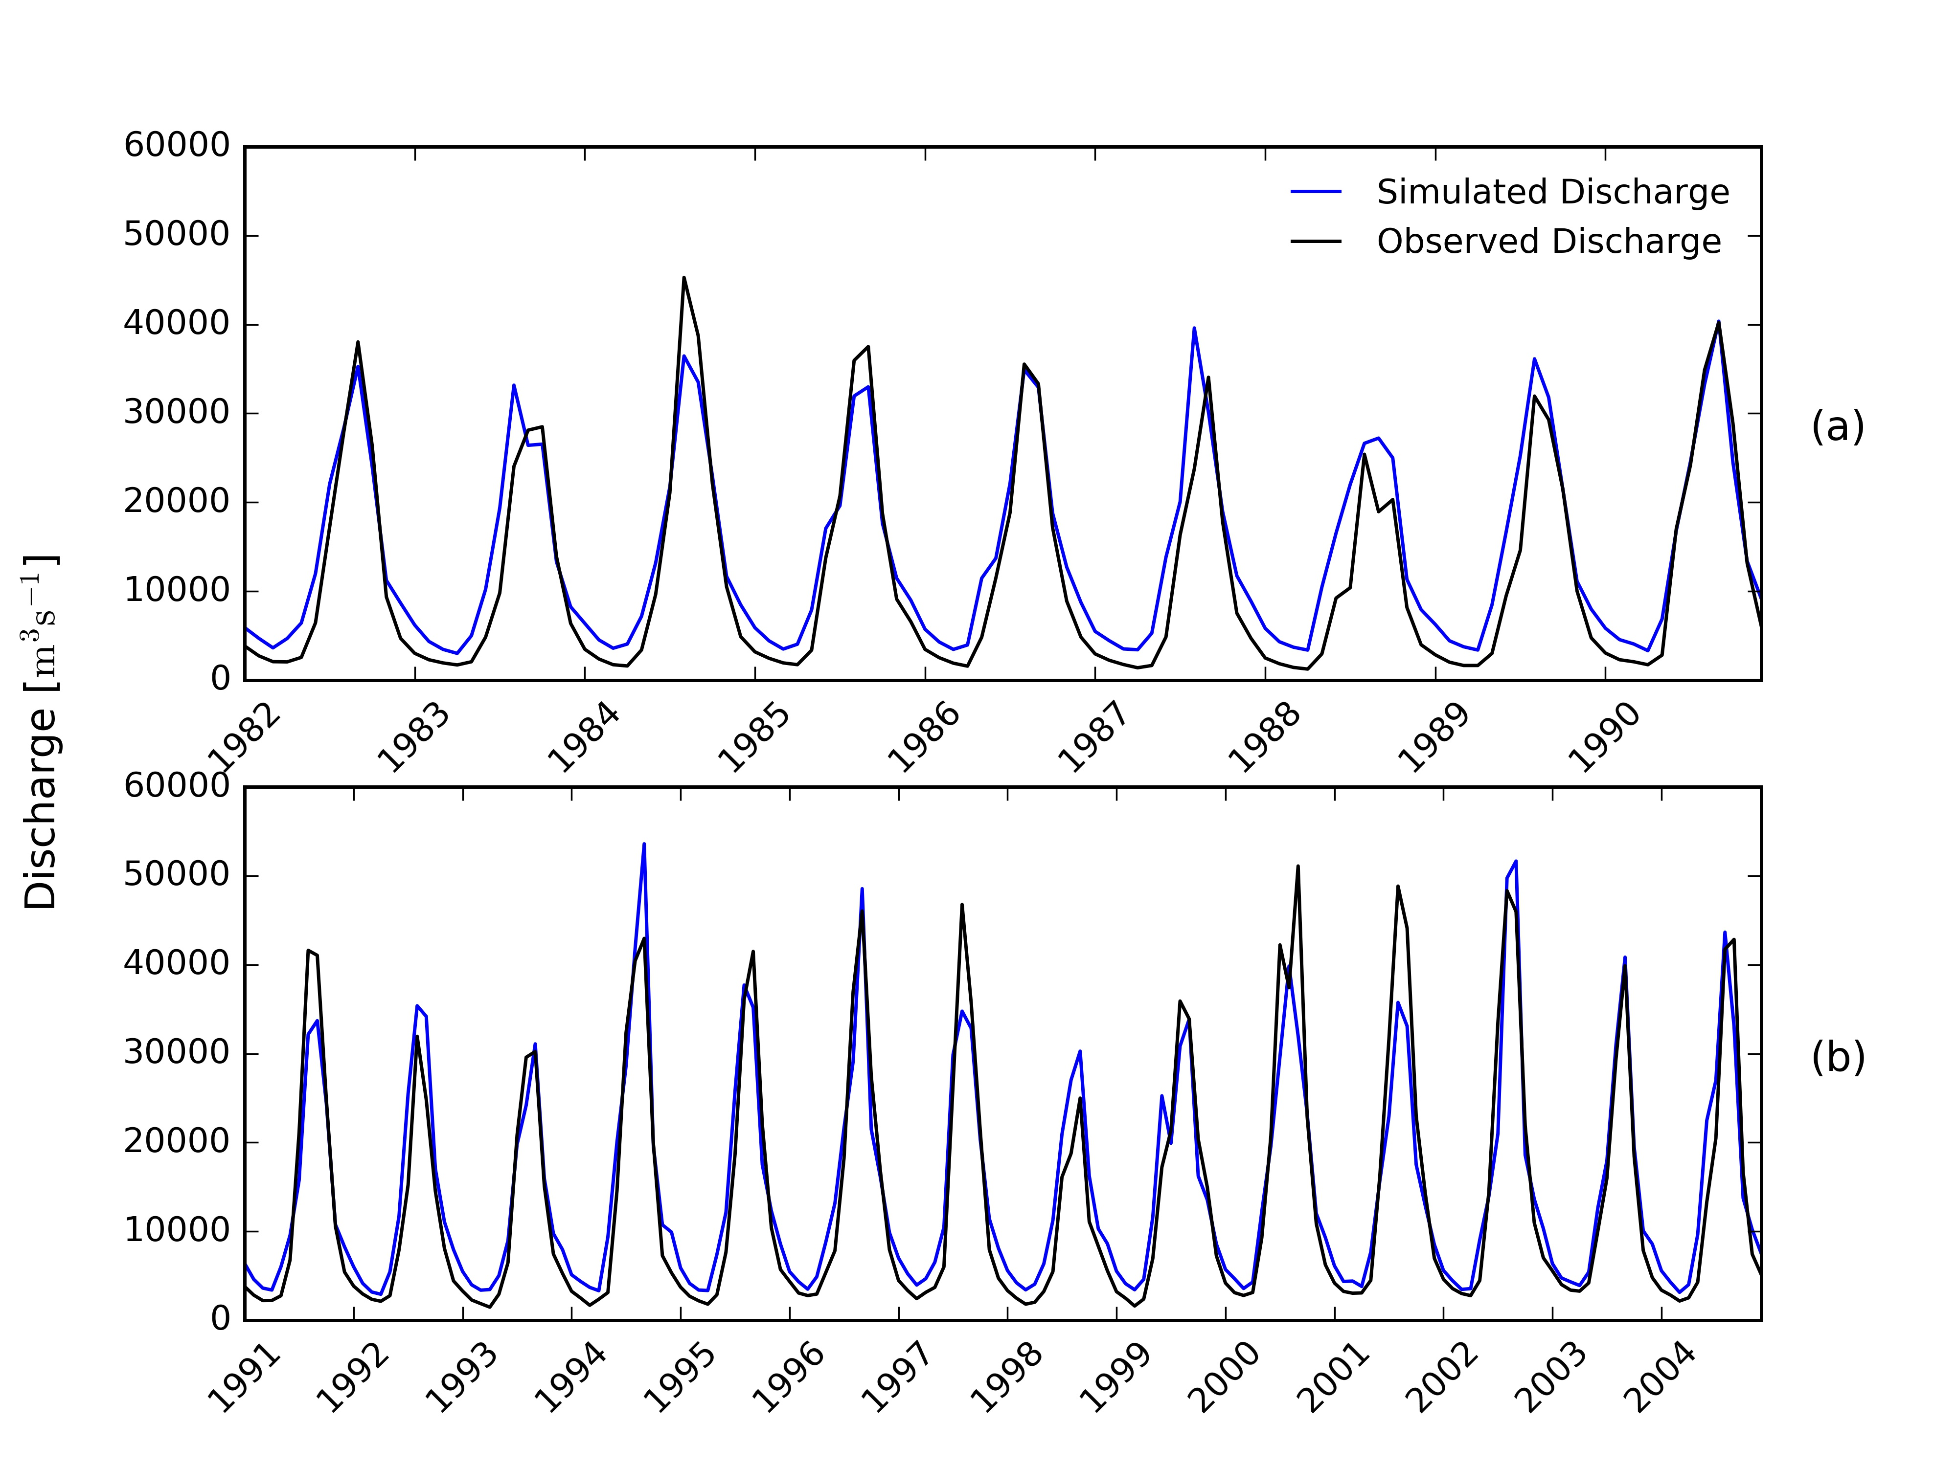
SIMULATION RESULTS
Followed similar model accuracy guidelines as Moriasi et al. [2007]
Model was found to perform very well for both periods
Statistic | R [-] | NSE [-] | PBIAS [%] | RSR [-] | MRE [%]
Calibration | 0.96 | 0.87 | -20.70 | 0.28 | 68.13
Validation | 0.95 | 0.89 | -7.40 | 0.24 | 41.95

Slide 18
INPUT DATA UNCERTAINTY
Model is calibrated with an observed dataset, however, a climate dataset is used to estimate the effects of climate variability on the LMB hydrology
How much uncertainty is there when using the climate dataset as an input into the hydrologic model?
Simulated calibration and validations periods using the climate reanalysis dataset

Slide 19
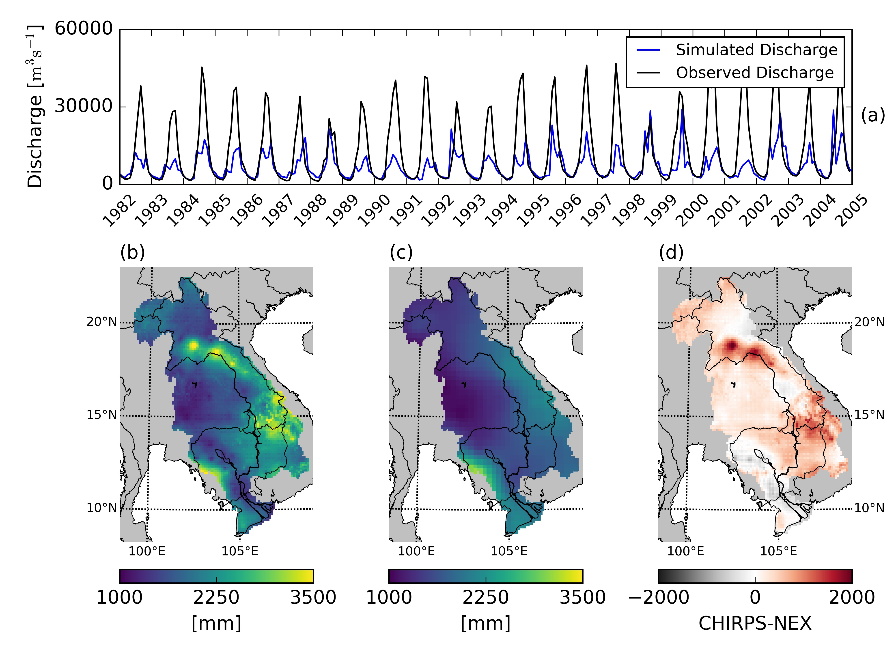
INPUT DATA UNCERTAINTY
The NEX climate reanalysis data greatly under predicts precipitation and consequently runoff
Climate dataset is at a coarser resolution (0.25°) which fails to capture intense rainfall events [Le et al., 2014]
Statistic | R [-] | NSE [-] | PBIAS [%] | RSR [-] | MRE [%]
Calibration | 0.67 | 0.17 | -44.28 | 0.55 | 44.74
Validation | 0.57 | 0.11 | -45.05 | 0.55 | 38.56

Slide 20
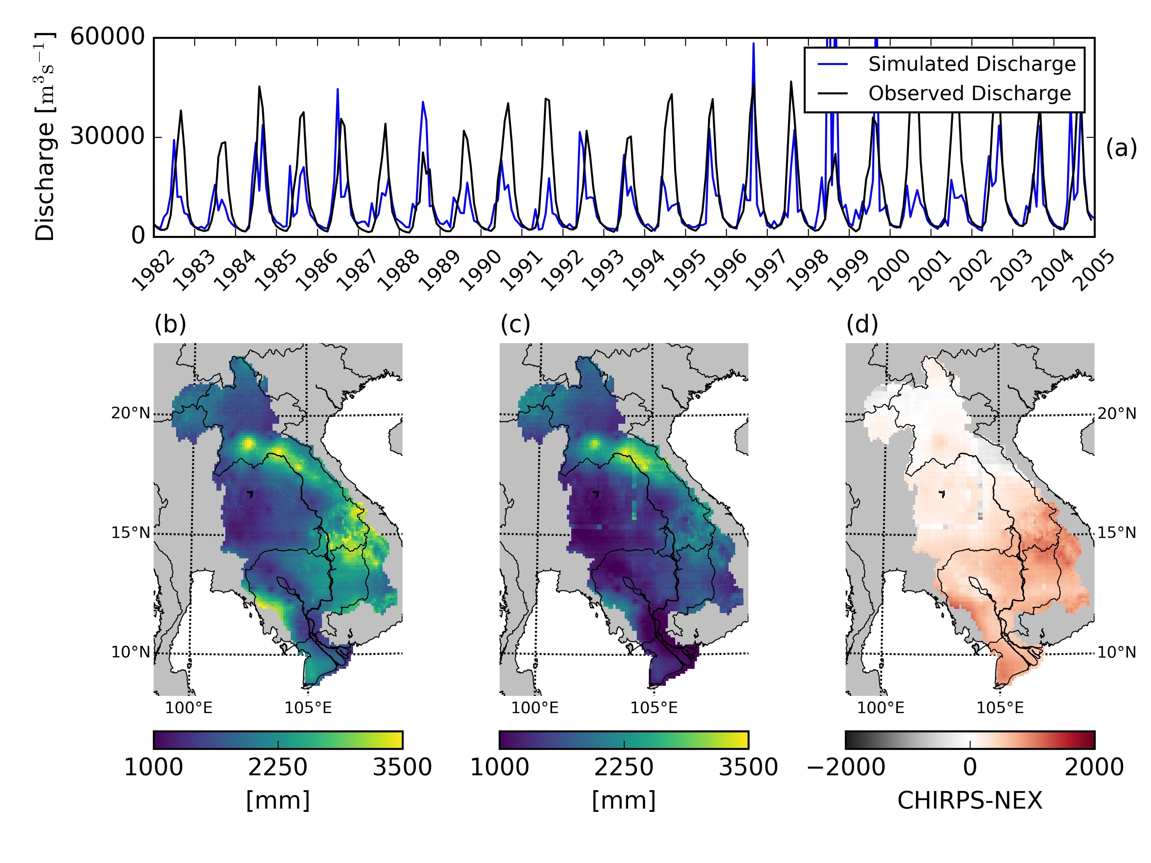
BIAS CORRECTION OF CLIMATE PRECIPITATION
Used the power transformation bias correction technique [Leander and Buishand, 2007; Leander et al., 2008]
Non-linear correction using an exponential form
Slightly improved precipitation inputs
Results not as accurate as needed
Statistic | R [-] | NSE [-] | PBIAS [%] | RSR [-] | MRE [%]
Calibration | 0.67 | 0.17 | -44.28 | 0.55 | 44.74
Validation | 0.57 | 0.11 | -45.05 | 0.55 | 38.56

Slide 21
ERRORS AND UNCERTAINTIES
Develop Land Cover Change Model
Run Land Cover Scenarios
Land Cover Data
Calibration and Validation
Setup VIC Hydrologic Model
Run Hydrologic Simulations
NEX Climate Data
Calibration and Validation
Precip. Bias Correction
Gridded Hydrologic Forcing
Climate Variability Effects
Analysis
Land Cover Change Effects

Slide 22
HYDROLOGIC SIMULATIONS
Two sets of simulations were run for this study each changing a specific input in the hydrologic model
Climate scenario: Simulation run with climate projection data. Land cover data for 2001 was kept constant
Both raw climate data and bias corrected data was analyzed
Land cover scenario: Simulation run with land cover projection data. Metrological data for 2001 was kept constant
- All land cover scenarios were used (baseline, forest +5%, forest +10%, agriculture +5%, and agriculture +10%)

Slide 23
HYDROLOGIC CHANGE ANALYSIS
Develop Land Cover Change Model
Run Land Cover Scenarios
Land Cover Data
Calibration and Validation
Setup VIC Hydrologic Model
Run Hydrologic Simulations
NEX Climate Data
Calibration and Validation
Precip. Bias Correction
Gridded Hydrologic Forcing
Climate Variability Effects
Analysis
Land Cover Change Effects

Slide 24
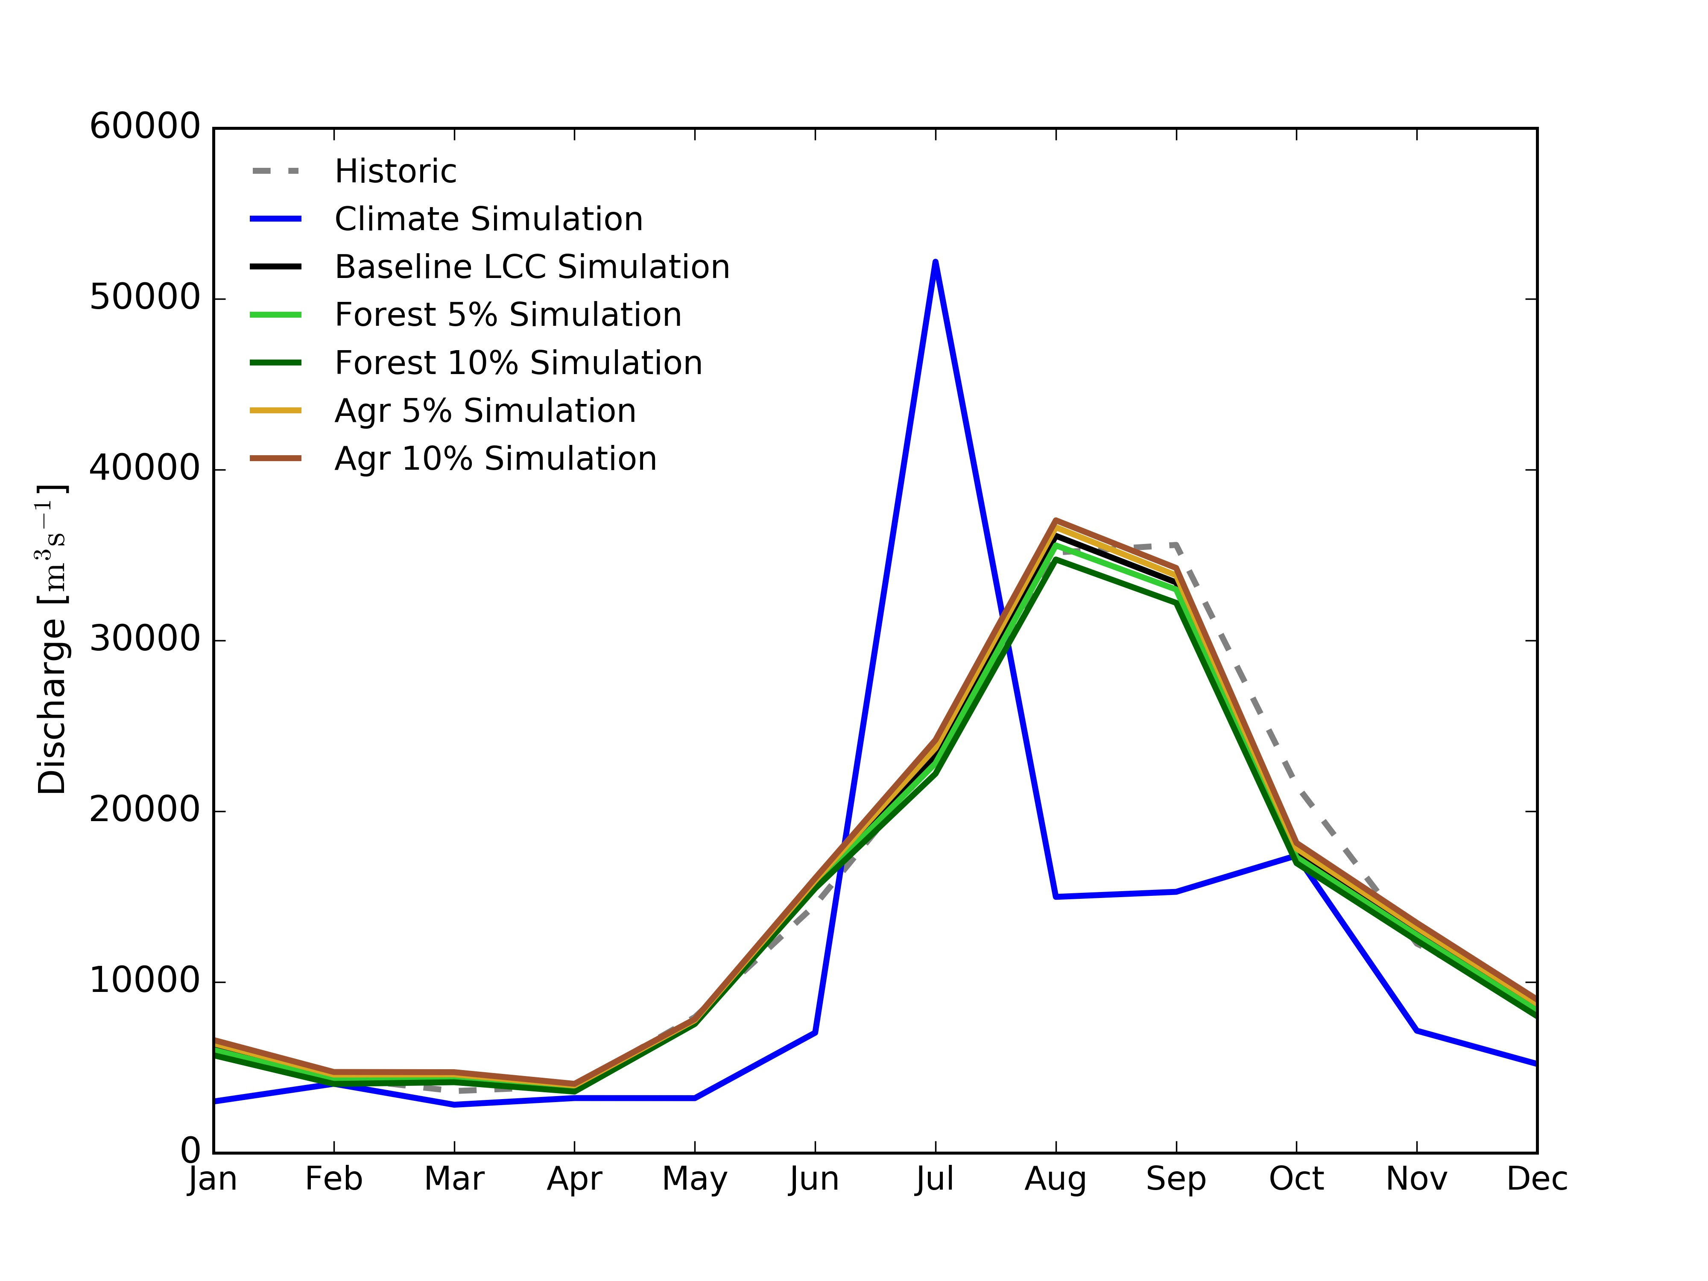
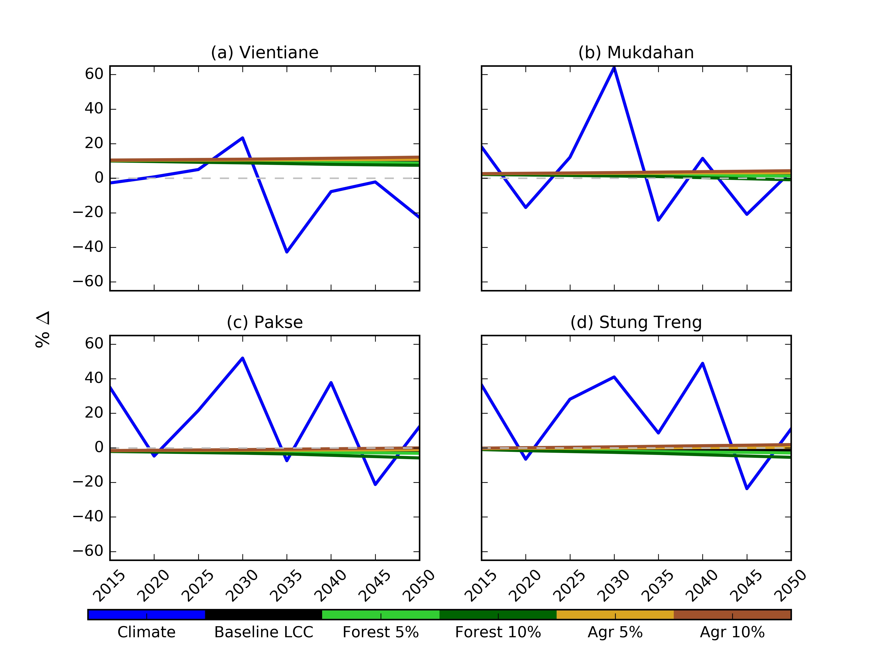
DISCHARGE CHANGES
Climate variability will make discharge inconsistent through time
Land cover will only slightly alter discharge
Increase in forest results in decreases in discharge
Increase in agriculture results in increases in discharge

Slide 25
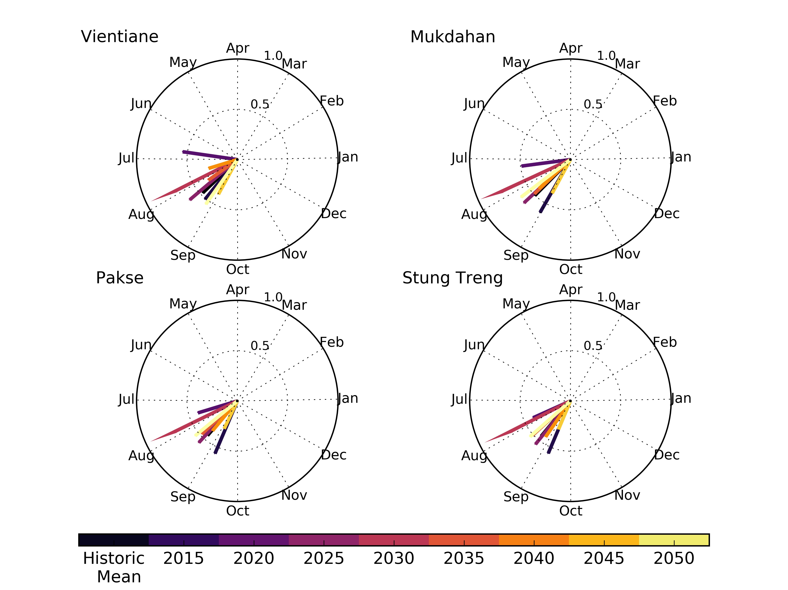
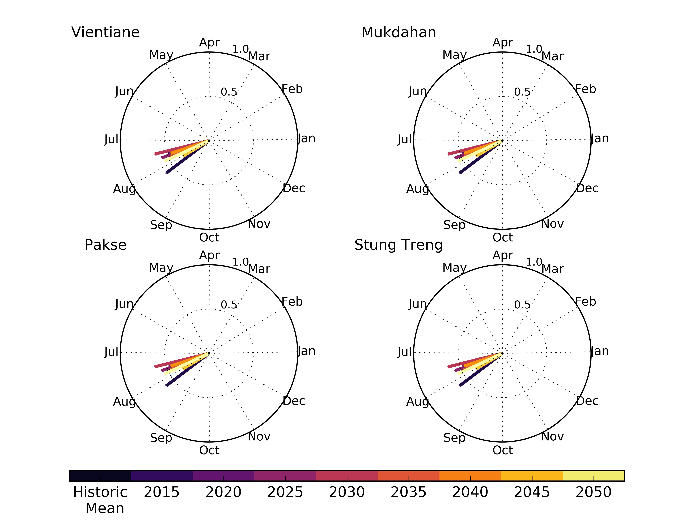
SEASONALITY
Modeled streamflow shows greater variability in seasonality and intensity when compared to historic observations
Precipitation seasonality shows less variability
Earlier dates for the peak season in both streamflow and precipitation
Streamflow Seasonality
Precipitation Seasonality

Slide 26
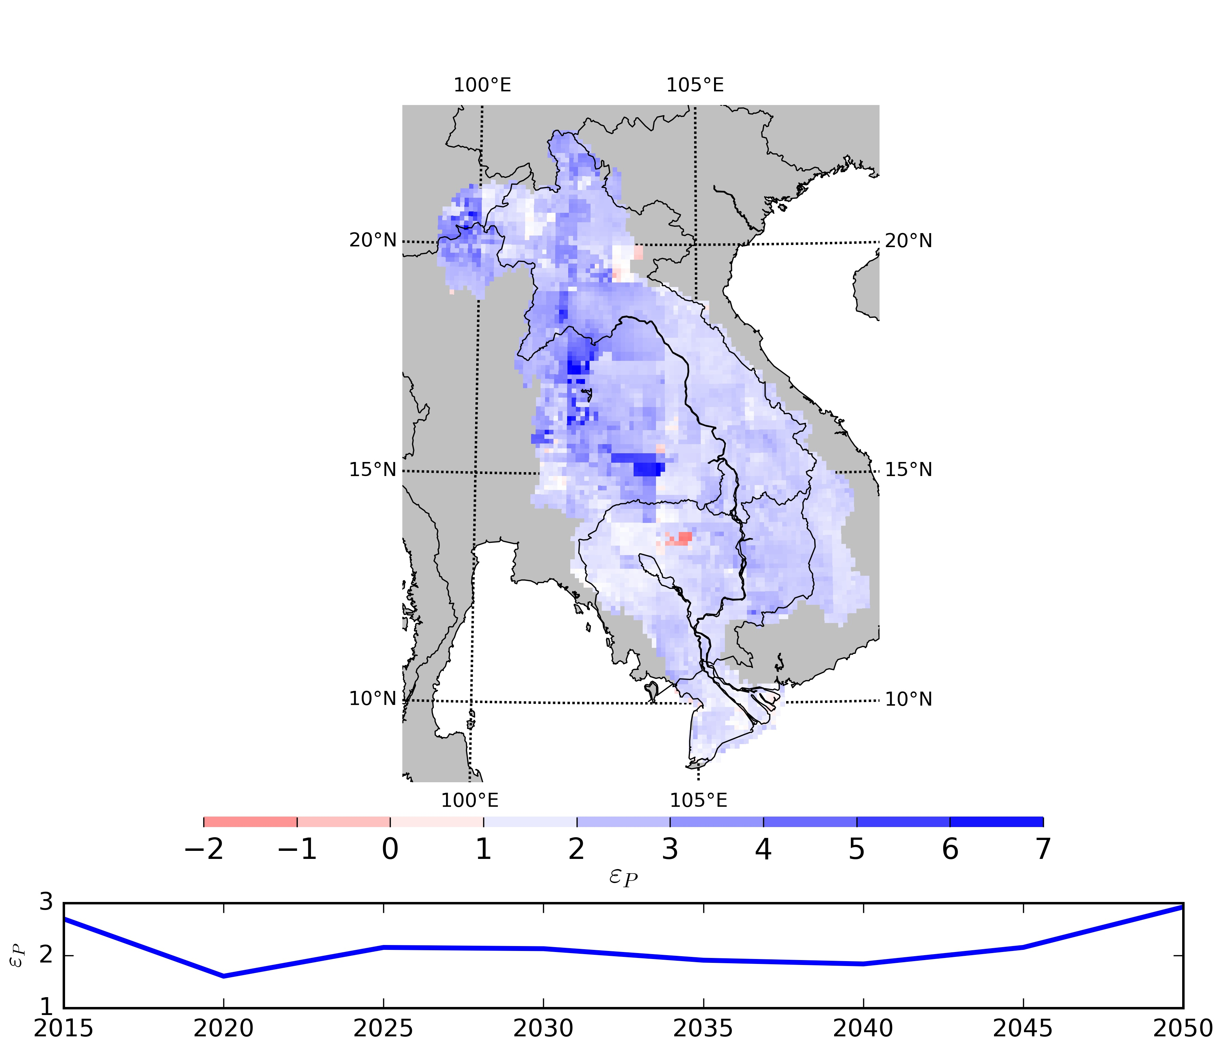
RUNOFF ELASTICITY
Runoff elasticity analysis shows there will be increases in runoff with increases in precipitation throughout the basin
There will be greater increases in runoff
in the northern and western portions of
the basin
On average, runoff will increase about
twice as much (~2% increase)
compared to precipitation
Little variability throughout time

Slide 27
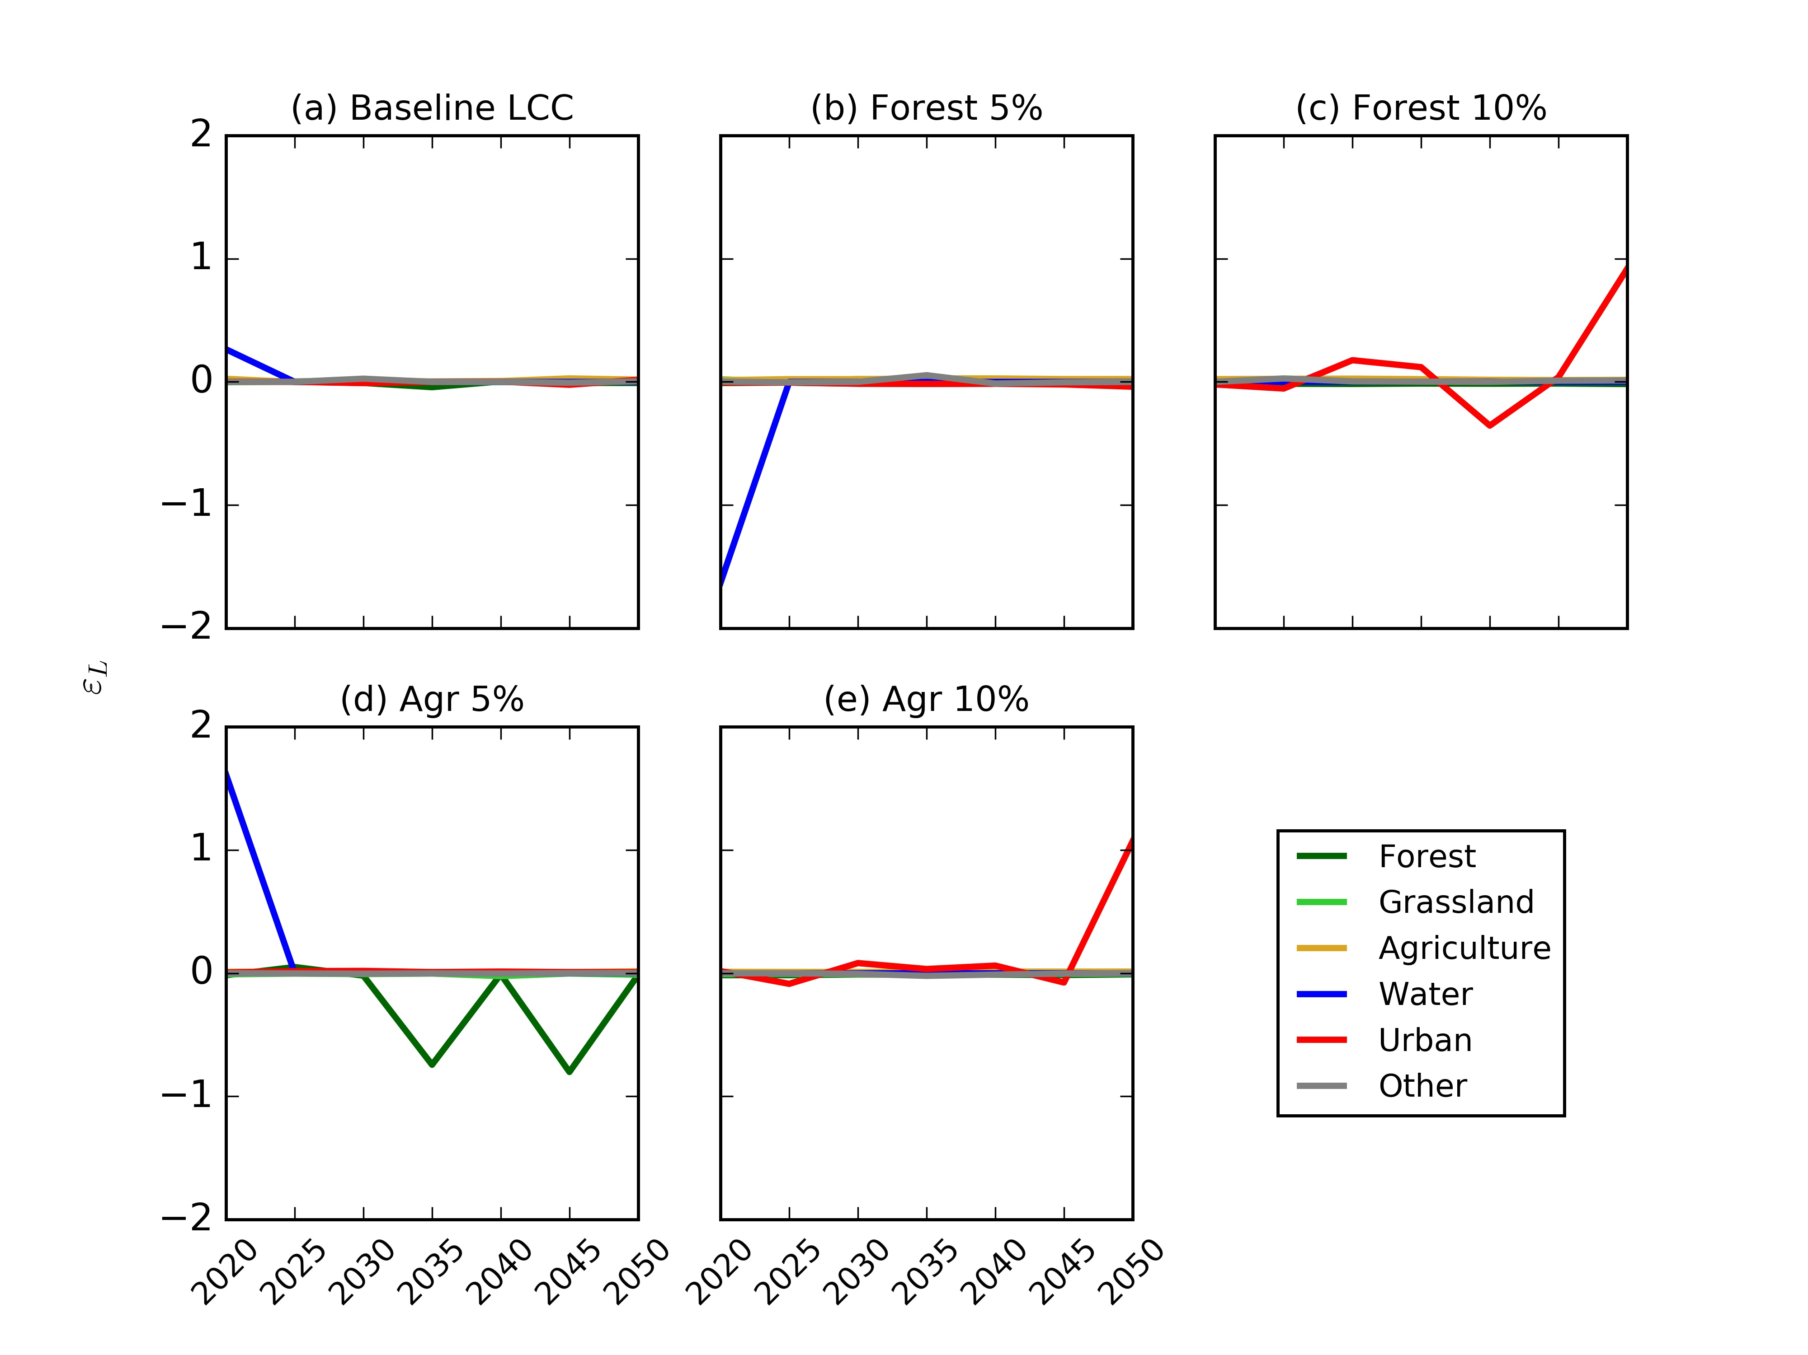
RUNOFF ELASTICITY
Runoff will have almost no change when compared to changes in land cover classes
Small changes occur for
urban, forest, and water
classes
These changes are so small
(< 1%) that they will have
minimal effects on the
environment

Slide 28
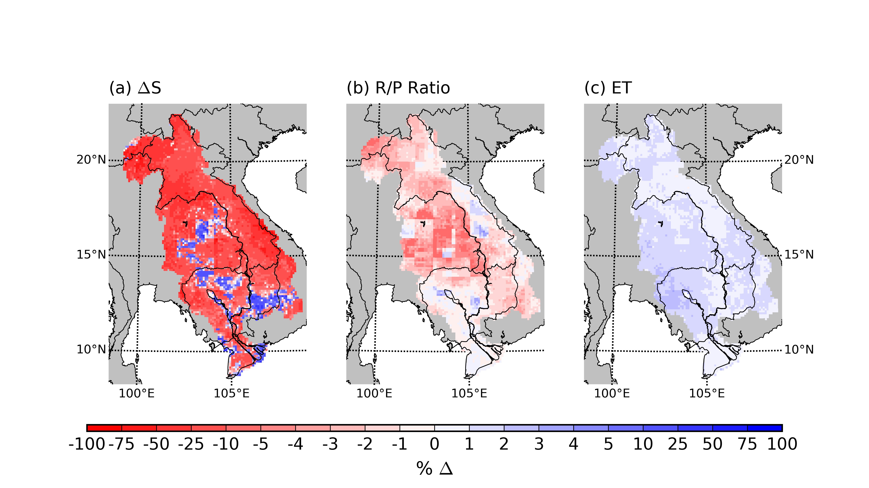
SPATIAL TRENDS
Water storage shows a decreasing trend across the majority of the basin due to climate variability
Less water stored in soil and trees
There is a decreasing trend in the runoff/precipitation (R/P) ratio
Lower percent of
precipitation contributing
to runoff
Small increasing trend
in evapotranspiration

Slide 29
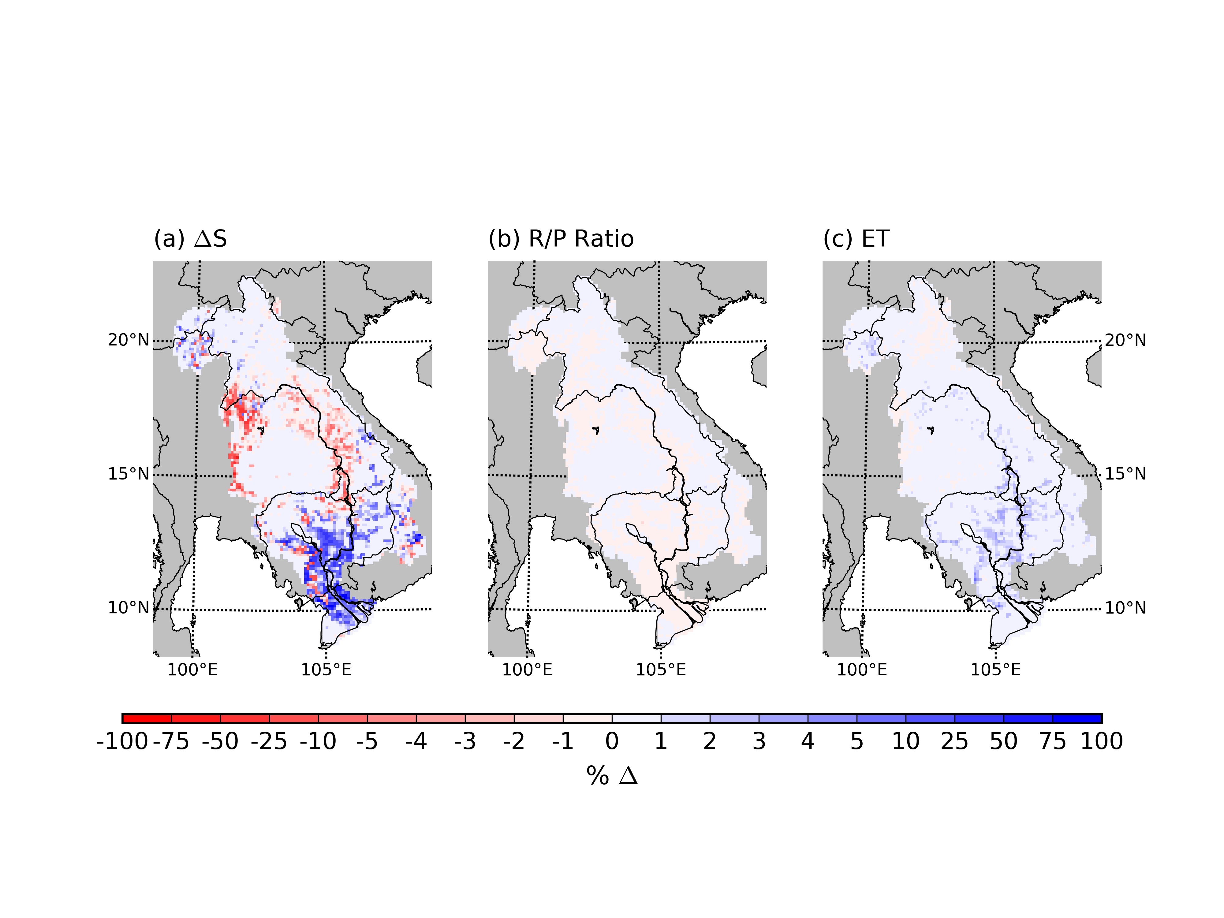
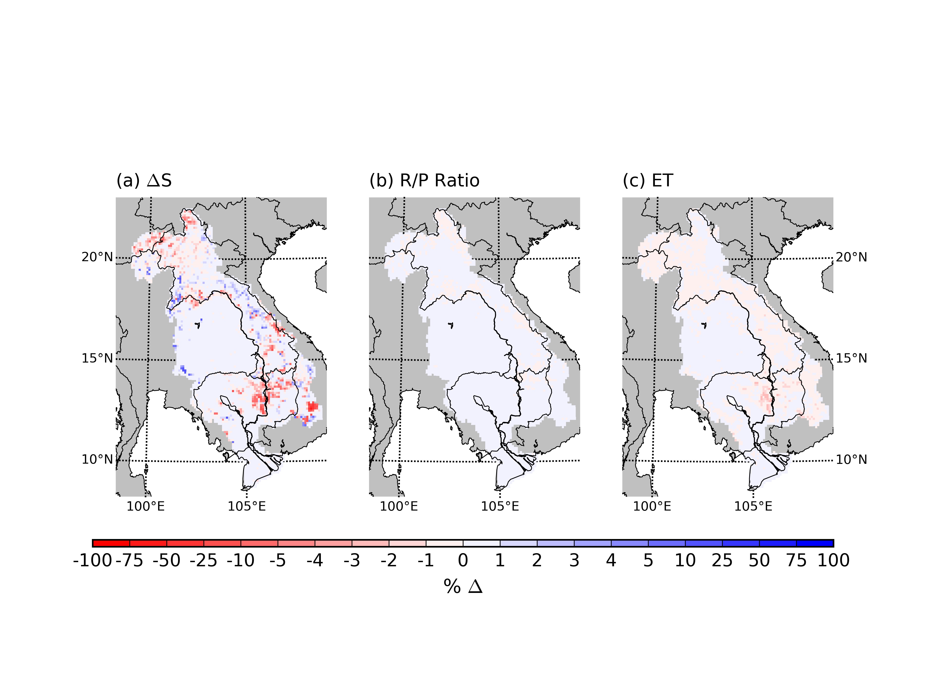
SPATIAL TRENDS
Small scale changes in water storage due to land cover change
Increase due to increases in forest, decrease due to increase in agriculture
Little changes in evapotranspiration due to land cover change
Almost no changes in the amount of precipitation that is converted to runoff

Slide 30
DECISION MAKING CONTEXT
Study has the possibility of providing information and data can be used by water resource managers to form new policies
Fits into water resource framework by characterizing status as is and simulating what will happened due to changes
Need to have extremely accurate data inputs and calibrations for accurate actionable information
By providing this information, decision makers can have a understanding of policy changes on the effect of hydrology
For example: reforestation policy can lead to a decrease in streamflow
Information from this study has too much uncertainty for accurate decision making

Slide 31
CONCLUSIONS
This study was conducted to investigate the spatial and temporal changes to the LMB hydrologic system due to climate variability and land cover change
A calibrated and validated land cover change model and hydrologic model along with a large hydrologic dataset is a result from work
Future work will have implications for long-term water resource management
More accurate climate and land cover data inputs can improve results
Basin wide policy can be formulated to help promote development during changes in the system

Slide 32
REFERENCES
D. Dudgeon (2000) Large-scale Hydrological Changes in Tropical Asia: Prospects for Riverine Biodiversity. Bioscience 50, 793-806.
Le T. B., et al. (2014) Hydrologic simulation driven by satellite rainfall to study the hydroelectric development impacts of river flow. Water 6, 3631-3651.
Leander, R. and T. A. Buishand (2007), Resampling of regional climate model output for the simulation of extreme river flows, J. Hydrol., 332 (3–4), 487–496.
Leander, R., T. A. Buishand, B. J. J. M. van den Hurk, and M. J. M. de Wit (2008), Estimated changes in flood quantiles of the river Meuse from resampling of regional climate model output, J. Hydrol., 351 (3–4), 331–343.
Liang, X., et al., (1994) A simple hydrologically based model of land surface water and energy fluxes for general circulation models. J. Geo. Res. 99, 14415-14428.
Lohmann, D., et al., (1996) A large-scale horizontal routing model to be coupled to land surface parameterization schemes. Tellus 48, 708-721.
Lohmann, et al., (1998) Regional scale hydrology: I. Formulation of the VIC-2L model coupled to a routing model, Hydrol. Sci. J., 43, 131-141.
Mancosu, N., et al. (2015) Water scarcity and future challenges for food production. Water 7, 975-992
Moriasi, D. N., et al. (2007) Model evaluation guidelines for systematic quantification of accuracy in watershed simulations. Transactions of the ASABE 50, 885-900.
Poulsen, A. F., et al. (2002) Fish migrations of the Lower Mekong River Basin: implications for development, planning and environmental management. MRC Technical Paper 8, Mekong River Commission, Phnom Penh, Cambodia, 1683-1489.
Sakamoto T., et al. (2006) Spatio–temporal distribution of rice phenology and cropping systems in the Mekong Delta with special reference to the seasonal water flow of the Mekong and Bassac rivers. Remote Sensing of Environment 100: 1-16.
Verburg, P. H., et al. (2002) Modeling the spatial dynamics of regional land use: The CLUE-S Model. Env. Management 30, 391-405

Slide 33
THANK YOU
Kel Markert
kel.markert@nasa.gov

